Slide 1
CS3391 Object Oriented Programming
Dr.D.Sivaganesan, Professor, PSGiTech / CSE
CS3391 Object Oriented Programming Dr.D.Sivaganesan and N.Aravindhraj PSGiTech / CSE
1

Slide 2
Generic Programming
Enables the programmer to create classes, interfaces and methods that automatically works with all types of data(Integer, String, Float etc.,)
It has expanded the ability to reuse the code safely and easily.
The Java Generics programming is introduced in J2SE 5 to deal with type-safe objects.
CS8392 Object Oriented Programming
Dr.D.Sivaganesan and N.Arvaindhraj PSGiTech / CSE
2

Slide 3
Advantage of Java Generics
Type-safety : We can hold only a single type of objects in generics. It doesn’t allow to store other objects.
Type casting is not required: There is no need to typecast the object.
Compile-Time Checking: It is checked at compile time so problem will not occur at runtime. The good programming strategy says it is far better to handle the problem at compile time than runtime.
CS8392 Object Oriented Programming
Dr.D.Sivaganesan and N.Arvaindhraj PSGiTech / CSE
3

Slide 4
Generic class
A class that can refer to any type of data members is known as a generic class.
Syntax :
Class classname<T>
{
T obj;
}
Object
classname <type> objname=new classname<type>(vlaue)
classname <type> objname=new classname(vlaue)
T type parameter - to create the generic class of specific type.
The T type indicates that it can refer to any type (like String, Integer, and Employee). The type you specify for the class will be used to store and retrieve the data.
CS8392 Object Oriented Programming
Dr.D.Sivaganesan and N.Aravindhraj PSGiTech / CSE
4

Slide 5
Type Parameters
The type parameters naming conventions are important to learn generics thoroughly. The common type parameters are as follows:
T, U - Type
E - Element
K - Key
N - Number
V - Value
CS8392 Object Oriented Programming Dr.D.Sivaganesan and N.Arvindhraj PSGiTech / CSE
5

Slide 6
class GC<T>
{
// An object of type T is declared T obj;
GC(T obj)
{ this.obj = obj;
} // constructor public T get()
{
return this.obj;
} }
CS8392 Object Oriented Programming
Dr.D.Sivaganesan and N.Aravindhraj PSGiTech / CSE
6

Slide 7
class exGC
{
public static void main (String[] args)
{ // instance of Integer type
GC <Integer> i = new GC<Integer>(15); System.out.println("Integer :"+i.get());
// instance of String type
GC <String> s = new GC<String>("RAM");
System.out.println("String :"+s.get());
GC <Character> c = new GC<Character>('K'); System.out.println("Character :"+c.get());
GC <Float> fv = new GC<Float>(123.45f); System.out.println("Float :"+fv.get());
} }
CS8392 Object Oriented Programming Dr.D.Sivaganesan and N.Arvindhraj PSGiTech / CSE
7

Slide 8
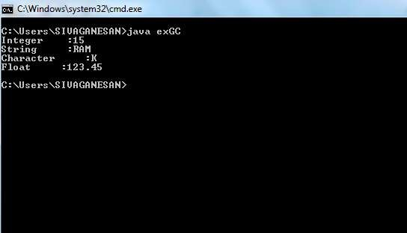
CS8392 Object Oriented Programming
Dr.D.Sivaganesan and N.Arvaindhraj PSGiTech / CSE
8

Slide 9
Generic class with multiple parameters
Syntax
Class classname<T,U>
{
T obj;
U obj;
}
Object
classname <type1,type2> objname=new classname<type1,type2>(val1,val2)
classname <type1,type2> objname=new classname(val1,val2)
CS8392 Object Oriented Programming
Dr.D.Sivaganesan and N.Aravindhraj PSGiTech / CSE

Slide 10
class GC<T,U>
{
// An object of type T is declared
T ob1; U ob2;
GC(T ob1,U ob2)
{
this.ob1 = ob1;
this.ob2=ob2;
} // constructor
public void display()
{
System.out.println(ob1+” “+ob2);
}}
class exGC2
{
public static void main
(String[] args)
{
// instance of Integer , Float
type
GC <Integer,Float> i = new
GC<Integer,Float>(75,234.56f);
System.out.println("Integer
and Float Values :");
i.display();
}
}
CS8392 Object Oriented Programming
Dr.D.Sivaganesan and N.Aravindhraj PSGiTech / CSE

Slide 11
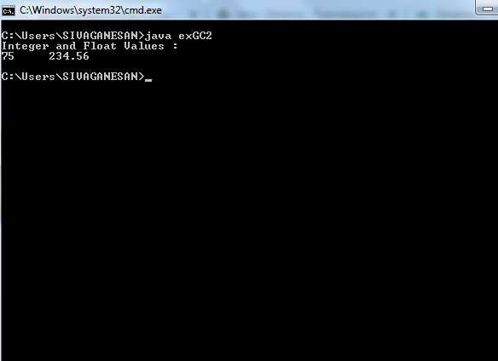
CS8392 Object Oriented Programmiang
Dr.D.Sivaganesan and N.Arvindhraj PSGiTech / CSE
11

Slide 12
Generic Methods
User can also write generic methods that can be called with different types of arguments based on the type of arguments passed to generic method, the compiler handles each method.
Syntax :
<T> void methodname (T arg)
{
statements;
}
CS8392 Object Oriented Programming
Dr.D.Sivaganesan and N.Aravindhraj PSGiTech / CSE

Slide 13
class GM
{ // A Generic method example
<T> void Display (T element) {
System.out.println(element.getClass().getName() + " = " + element);
}
public static void main(String[] args)
{ GM ob=new GM();
// Calling generic method with Integer argument
ob.Display(23);
// Calling generic method with String argument ob.Display("KUMAR");
// Calling generic method with double argument
ob.Display(1.0); } }
CS8392 Object Oriented Programming
Dr.D.Sivaganesan and N.Aravindhraj PSGiTech / CSE

Slide 14
class GM
{ // A Generic method example
<T,U> void Display (T element,U val) { System.out.println(element.getClass().getName() + " = " + element);
System.out.println(val.getClass().getName() + " = " + val);
}
public static void main(String[] args)
{ GM ob=new GM();
// Calling generic method with Integer and String argument
ob.Display(23,"siva");
} }
CS8392 Object Oriented Programming
Dr.D.Sivaganesan and N.Aravindhraj PSGiTech / CSE

Slide 15
public class GMArray
{
public static < E > void printArray(E[] val)
{for ( E element : val)
{System.out.println(element );}System.out.println();} public static void main( String args[] ) {
Integer[] intArray = { 10, 20, 30, 40, 50 }; Character[] charArray = { 'J', 'A', 'V', 'A'};
System.out.println( "Printing Integer Array" ); printArray( intArray );
System.out.println( "Printing Character Array" );
printArray( charArray );}}
CS8392 Object Oriented Programming
Dr.D.Sivaganesan and N.Arvaindhraj PSGiTech / CSE

Slide 16
Generic class with Bounded type
The type parameters could be replaced by any class .
This is fine for many purposes, but sometimes it is useful to limit the types that can be passed to a type parameter
Syntax :
Class classname <T extends superclass>
{
Statements;
}
Object creation
classname < superclass > object = new
classname < superclass >(new superclass());
CS8392 Object Oriented Programming
Dr.D.Sivaganesan and N.Aravindhraj PSGiTech / CSE

Slide 17
class A
{ int a=10,b=20;
public void displayClassA()
{ int c=a+b;
System.out.println("Inside super class A");
System.out.println("Addition Result
} }
class sample<T extends A>
:"+c);
{ T ob;
public sample(T obj){ this.ob = obj; }
public void print(){ this.ob.displayClassA(); } }
CS8392 Object Oriented Programming
Dr.D.Sivaganesan and N.Arvaindhraj PSGiTech / CSE

Slide 18
public class BGC
{
public static void main(String a[])
{
sample<A> s = new sample<A>(new A()); s.print();
}
}
CS8392 Object Oriented Programming
Dr.D.Sivaganesan and N.Aravindhraj PSGiTech / CSE

Slide 19
Multiple Bounds
Bounded type parameters can be used with methods as well as classes and interfaces.
Java Generics supports multiple bounds also, i.e . In For example A can be an interface or class. If A is class then B and C should be interfaces.
We can’t have more than one class in multiple bounds.
Syntax :
Class classname <T extends superclass & interface>
{
Statements;
}
CS8392 Object Oriented Programming Dr.D.Sivaganesan and N.Arvindhraj PSGiTech / CSE
19

Slide 20
interface B
{
int a=20;
void displayClassA();
}
class A implements B
{
int b=50;
public void displayClassA()
{ int c=a+b;
System.out.println("Inside class A");
System.out.println("Addition Result :"+c);
} }
CS8392 Object Oriented Programming
Dr.D.Sivaganesan and N.Aravindhraj PSGiTech / CSE

Slide 21
class sample<T extends A&B>
{ T ob;
public sample(T obj){
this.ob = obj;
}
public void print(){
this.ob.displayClassA();
} }
public class BGC2
{ public static void main(String a[])
{
sample<A> s = new sample<A>(new A()); s.print(); } }
CS8392 Object Oriented Programming
Dr.D.Sivaganesan and N.Aravindhraj PSGiTech / CSE

Slide 22
Restrictions on Generics
To use Java generics effectively, you must consider the
following restrictions:
Cannot Instantiate Generic Types with Primitive Types
Pair<int, char> p = new Pair<>(8, 'a');
Cannot Create Instances of Type Parameters
E elem = new E();
Cannot Declare Static Fields Whose Types are Type Parameters
static T os;
Cannot Use Casts or instance of With Parameterized Types
(String(var))
CS8392 Object Oriented Programming
Dr.D.Sivaganesan and N.Aravindhraj PSGiTech / CSE

Slide 23
Cannot Create Arrays of Parameterized Types
Gen<Integer> gens[] = new Gen<Integer>[10];
Cannot Create, Catch, or Throw Objects of Parameterized Types
catch (T e)
Cannot Overload a Method Where the Formal Parameter Types of Each Overload Erase to the Same Raw Type
public void print(Set<String> strSet) { } public void print(Set<Integer> intSet) { }
CS8392 Object Oriented Programming
Dr.D.Sivaganesan and N.Aravindhraj PSGiTech / CSE

Slide 24

CS8392 Object Oriented Programming
Dr.D.Sivaganesan and N.Arvindhraj PSGiTech / CSE

